Slide 1
Object Oriented Analysis & Design Module-5 (RL 5.2.5)
Harvinder S Jabbal

Slide 2
Draw Class Diagram for PoS System

Slide 3
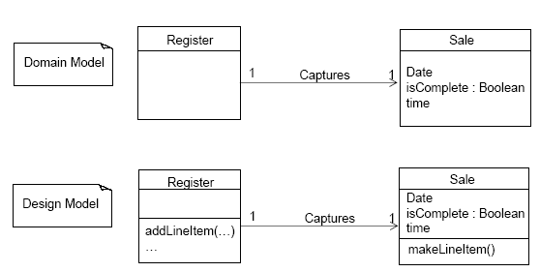
Domain Model vs. Design Model Classes

Slide 4
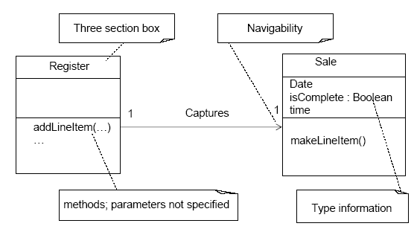
An Example DCD

Slide 5
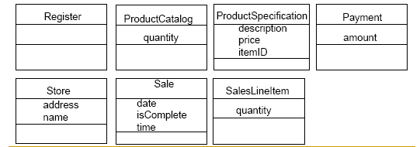
Creating a NextGen POS DCD
Identify all the classes participating in the software solution. Do this by analyzing the interaction diagrams. Draw them in a class diagram.
Duplicate the attributes from the associated concepts in the Domain Model.

Slide 6
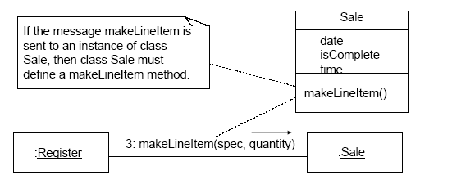
Creating a NextGen POS DCD
Add method names by analyzing the interaction diagrams.
The methods for each class can be identified by analyzing the interaction diagrams.

Slide 7
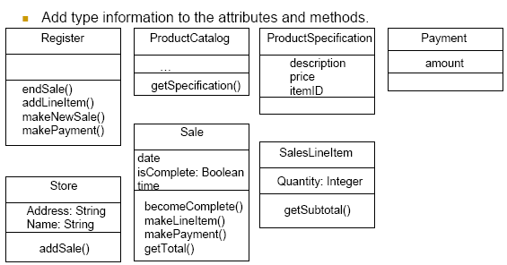
Creating a NextGen POS DCD

Slide 8
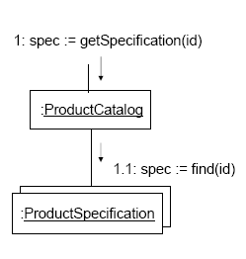
Method Names -Multiobjects
The find message to the multiobject should be interpreted as a message to the container/ collection object.
The find method is not part of he ProductSpecification class.

Slide 9
Associations, Navigability, and Dependency Relationships
Add the associations necessary to support the required
attribute visibility.
Each end of an association is called a role.
Navigability is a property of the role implying visibility of the
source to target class.
Attribute visibility is implied.
Add navigability arrows to the associations to indicate the
direction of attribute visibility where applicable.
Common situations suggesting a need to define an
association with navigability from A to B:
A sends a message to B.
A creates an instance of B.
A needs to maintain a connection to B
Add dependency relationship lines to indicate non-attribute
visibility.

Slide 10
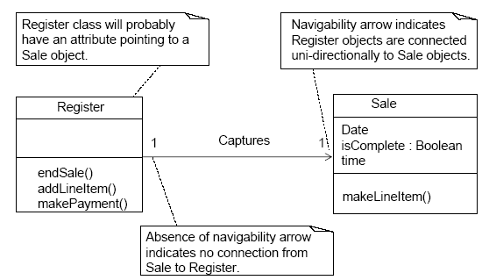
Creating a NextGen POS DCD

Slide 11
Acknowledgement
Slides are based on Course Text Books:
Applying UMP and Patterns (An Introduction to Object-Oriented Analysis and Design and Iterative Development) : Craig Larman
UMP Distilled (A Brief Guide to the Standard Object Modeling Langauge) : Martin Fowler
Design Patterns (Elements of Reusable Object-Oriented Software) : Erich Gama | Richard Helm | Rapph Johnson | John Vlissides alias GoF.
http://creately.com/diagram-type/article/simple-guidelines-drawing-uml-class-diagrams

